Slide 1

IRIS:
GETTING MORE OUT OF YOUR WELLS!
Victoria Pons, Ph. D.
Senior Chief Scientist
Automation & Optimization
Artificial Lift Research
Victoria.pons@bhge.com

Slide 2

Introduction & Background
When an oil well stops flowing naturally, artificial lifts methods are needed to stimulate the well’s production.
One of the most widely used method of artificial lift is reciprocating rod lift.
In reciprocating rod lift, a downhole pump is connected to the surface driving mechanism with a rod string.
The motion of the prime mover is translated into the vertical motion of the rod string, therefore lifting the production fluids to the surface.

Slide 3
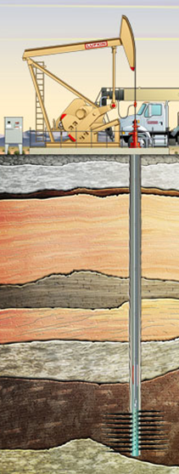
Introduction & Background
Work done at the surface is not equal to the work done at the pump.
Because of the elasticity, the rod string will compress and extend as the pumping unit goes up and down.
Essentially, the tapered rod string stretches and compresses, as the stress waves, created through the dynamics of pumping cycle, go up and down the rod string at the speed of sound.

Slide 4
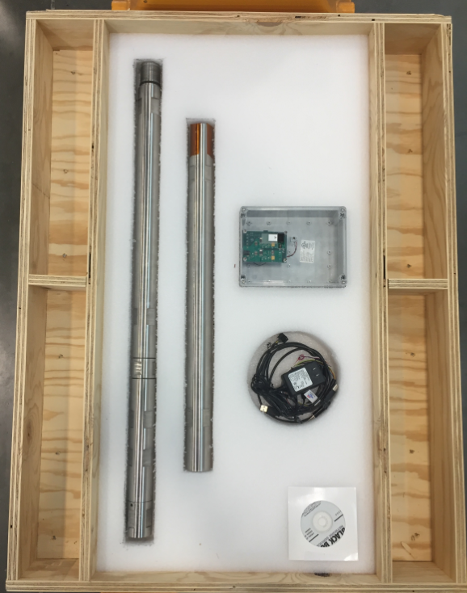
Introduction & Background
At the surface, a dynamometer and position sensor record the position and load data.
Unfortunately, similar recording of downhole position and load data is not commonly available since it requires a downhole dynamometer tool to be placed in the bottom of the rod string.
However…Deviated downhole data can be recorded with BHGE high temperature/memory dynamometer tool.
Traditionally, downhole data is calculated using surface data using the 1D damped wave equation.

Slide 5
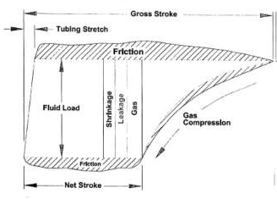
Downhole Data
Downhole data processing is a more accurate, reliable and robust way of optimizing reciprocating rod lift wells.
Key control parameters must be extracted from downhole data such as:
Pump fillage
Pump intake pressure (PIP)
Fluid load
Inferred production
Volumetric displacement

Slide 6
Control Parameters
Fluid load – F0
        excess friction detection
        validation of viscous damping forces
        calculate inferred production, efficiency, fluid level…
Netstroke – Ns
        plunger travel
        calculate inferred production, efficiency…
Standing valve opening – SVO
        unanchored tubing/rod stretch
        un-swept plunger distance due to gas expansion
        detect downhole conditions
Standing valve closing – SVC
        occurs at the top of stroke TOS
        calculate pump intake pressure (PIP)
        detect presence of extra friction/downhole condition
Traveling valve opening – TVO
        calculate pump discharge pressure (PDP)
Traveling valve closing - TVC

Slide 7
Pumped Off / Fluid Pound
If a well is pumped too fast, the rate at which the production fluids are extracted from the wellbore is greater than the rate of the reservoir supplying the fluids to the wellbore.
This is a condition commonly known as fluid pound or “pumped off”.
Fluid pound is a downhole condition that should be avoided at all costs.

Slide 8
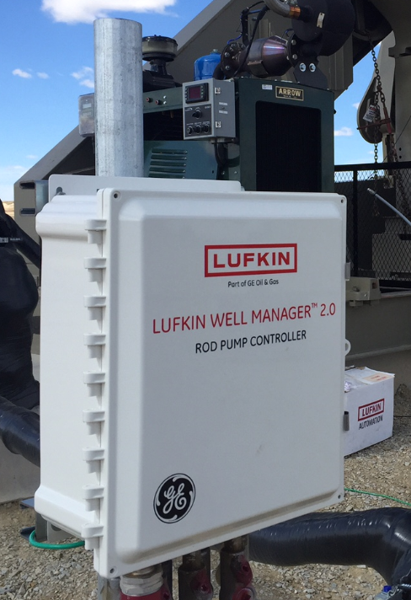
Key parameters and Control
These quantities enable the user to make control decisions such as slowing down or stopping the pumping unit to detect fluid pound caused by low pump fillage.
The efficiency of the overall pumping unit installation can be assessed enabling the user to make control decision (such as for example installing a different pump, decreasing speed…) to improve their reciprocating rod lift installation.

Slide 9
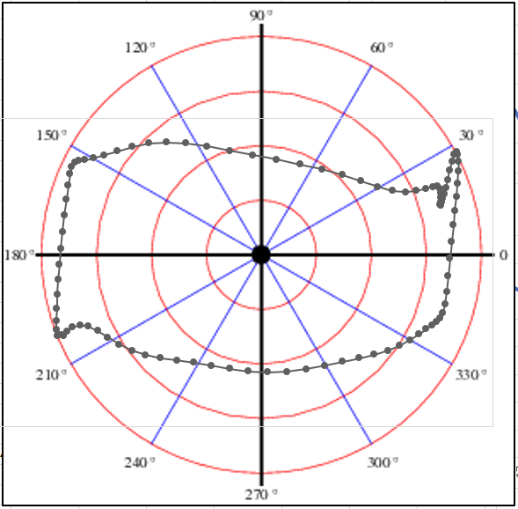
IRIS
IRIS is comprised of a series of algorithms
Improved data analysis
Improved decision making
IRIS transforms downhole or surface position and load data into polar coordinates
Facilitates accurate computation of key control variables
Identifies downhole conditions present

Slide 10
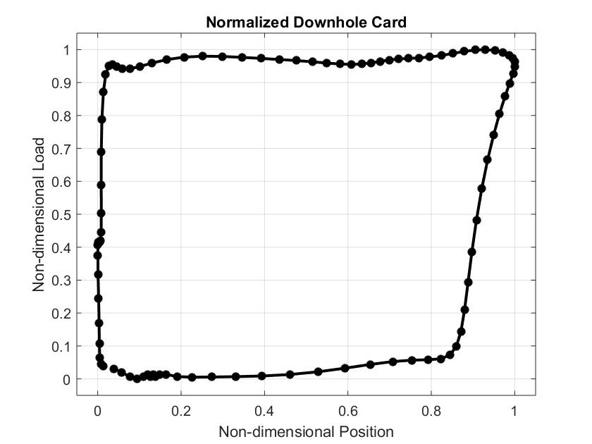

Normalized downhole data
The first step in downhole data transformation is normalizing the downhole card.
Position and load data are divided by their respective spans
$$For i=1,…,N:$$
$$NP\left(x\right)=\frac{P(x)}{R_{P}},$$
$$NL\left(x\right)=\frac{L(x)}{R_{L}}.$$

Slide 11
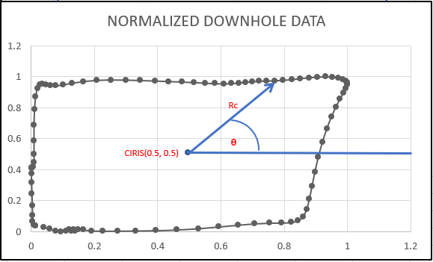

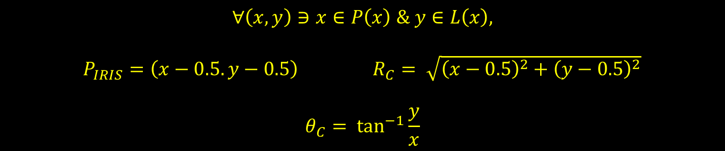
From Cartesian to re-centered Polar coordinates
The polar coordinates center is (0.5,0.5), this involves a change in coordinates.
Every point of the normalized data set is shifted to have $C_{IRIS}\left(0.5,0.5\right)$ as the center of the new coordinate system.
0º, 360º
$$∀\left(x,y\right)∋x∈P\left(x\right) \& y∈L\left(x\right),$$
$P_{IRIS}=\left(x−0.5. y−0.5\right)$ $R_{C}= \sqrt{{\left(x−0.5\right)}^{2}+{\left(y−0.5\right)}^{2}}$
$$θ_{C}= \tan^{−1}{\frac{y}{x}}$$

Slide 12
Never seen before data sets: RC and Theta

Slide 13
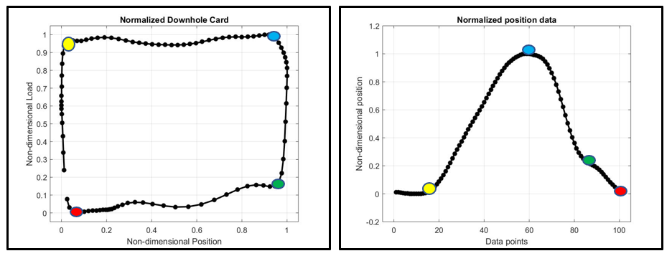
Identifying Valve Openings and Closing
SVO
SVC
TVO
TVC

Slide 14
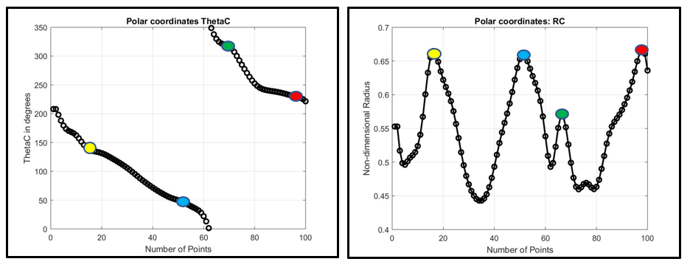
Calculate Valve Openings and Closings
SVO
SVC
TVO
TVC

Slide 15

Application of Radius data set
Critical points for the radius data can be calculated by solving $R_{C}^{′}\left(x\right)=0.$
For each critical point, if $R_{C}′(x)$ changes from positive to negative, then $R_{C}(x)$ has a local maximum.
If $R_{C}′(x)$ changes from negative to positive, then $R_{C}(x)$ has a local minimum.
If $R_{C}^{′′}\left(x\right)>0$, then the function$R_{C}(x)$ is concave up. If $R_{C}^{′′}\left(x\right)<0$, then the function$R_{C}(x)$ is concave down, whereas if changes from positive to negative, then $R_{C}(x)$ has a local maximum.

Slide 16
Application of Reference data set
Reference angles belonging to [150°, 200°] corresponds to the rod stretching as it is lifted by the pumping unit on the upstroke. Reference angles belonging to [30°, 150°] corresponds to the part of the upstroke when the plunger moves up.
Reference angles belonging to [340°, 30°] corresponds to the rods compressed back to their original state during the downstroke, while reference angles belonging to [210°, 330°] corresponds to the rest of the downstroke as the plunger moves back to its original position.

Slide 17
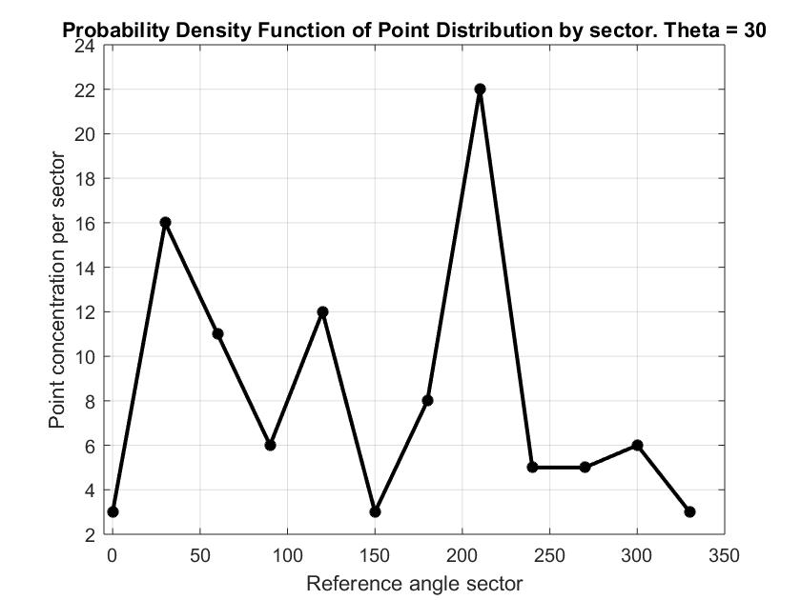
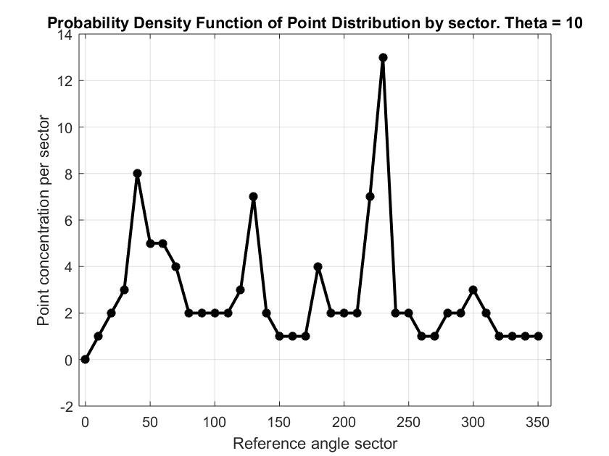

Probability Density Function Point Distribution
IRIS polar coordinates can be sorted by any angle increment
Adjust angle increment ($θ_{S}$ = 5°, 10°, 15°… ) for coarser or finer results
A probability density function is created to identify areas of highest point concentration
Accumulation of data points indicates that the rod string slowed down at a particular point in the pumping stroke
Slowing down phenomenon can be attributed to normal pumping operation
Accumulation of points can also be attributed to a wellbore event such as a moderate to severe dog leg.

Slide 18
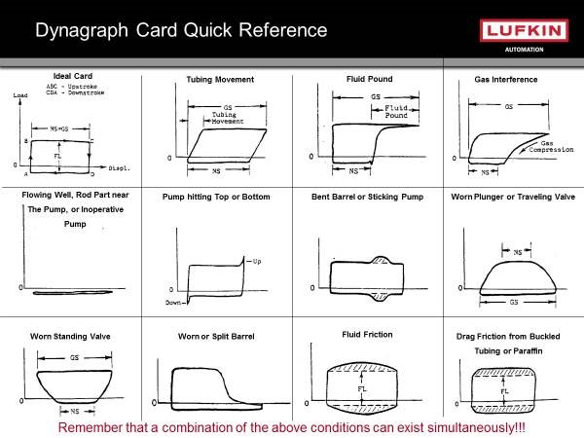
IDEAL CARDS

Slide 19
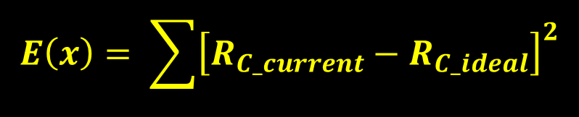
Pattern Matching / Downhole Event Indicator
Pattern matching per sector is an effective tool to diagnose and optimize a downhole well:
  guide the accurate and reliable calculation of key control parameters
  ideal downhole condition polar coordinate data and computed parameters
Using the newly created radius, reference angle and corresponding probability density function, current cards can be compared with ideal cards’ radius, reference angle and probability density function per sector.
Least squares is used to calculate degree of compatibility between the current data and ideal data using:
$$E\left(x\right)= \sum{{\left[R_{C_current}−R_{C_ideal}\right]}^{2}}$$

Slide 20
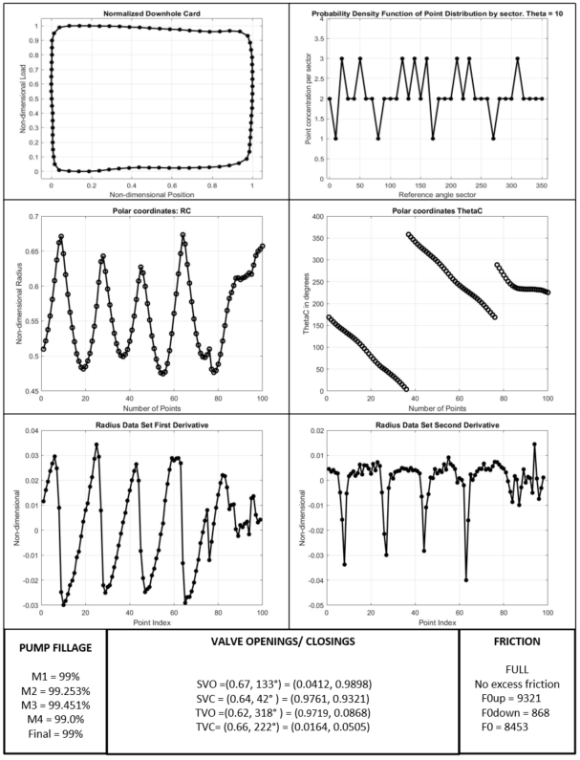
Results: Example 1 – Full

Slide 21
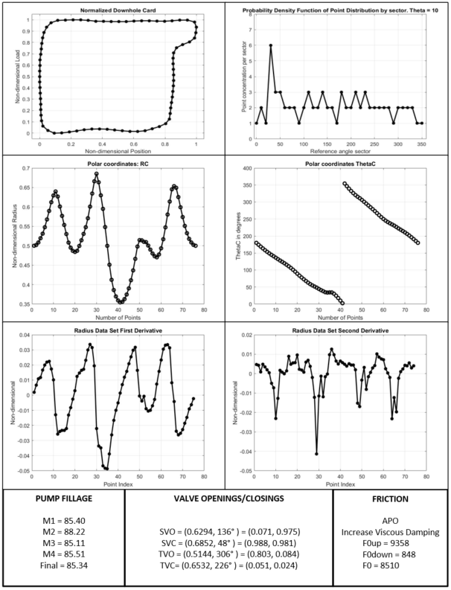
Results: Example 2 – Anchored Pumped Off

Slide 22
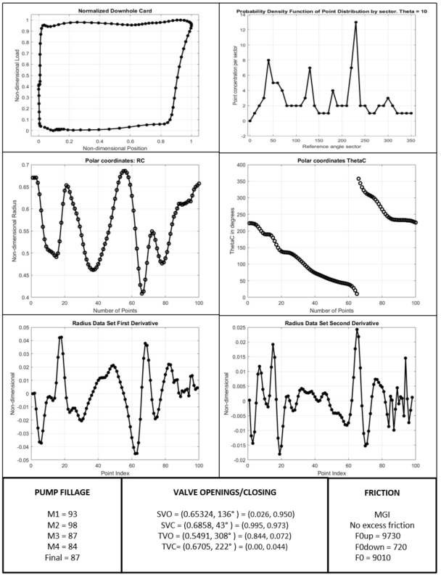
Results: Example 3 – Mild Gas Interference

Slide 23
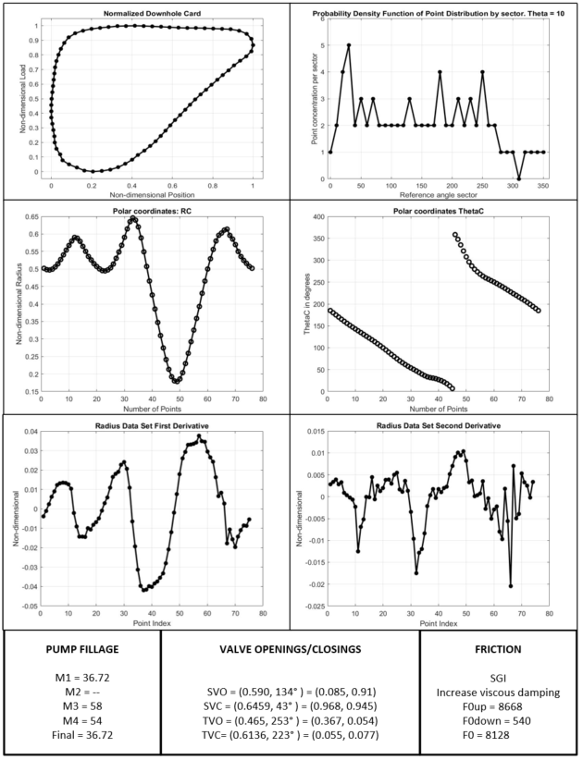
Results: Example 4 – Severe Gas Interference

Slide 24
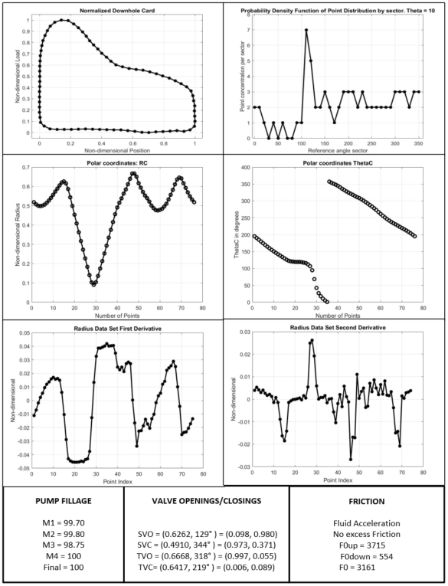
Results: Example 5 - Fluid Acceleration

Slide 25
Conclusions
IRIS is a comprehensive self-learning algorithm, which offers reliable, robust and accurate calculation of key control parameters necessary for reciprocation rod lift optimization.
This innovative method creates three new data sets by changing the point of reference from outside the downhole card to inside.
IRIS calculates key control parameters such as pump fillage, fluid load, valve opening and closings.
Automatic friction assessment provides accurate handling of viscous and mechanical friction.

Slide 26
Questions?
Thank you.
Victoria Pons
Victoria.pons@bhge.com

Slide 27
Copyright
Rights to this presentation are owned by the company(ies) and/or author(s) listed on the title page. By submitting this presentation to the Sucker Rod Pumping Workshop, they grant to the Workshop, the Artificial Lift Research and Development Council (ALRDC), and the Southwestern Petroleum Short Course (SWPSC), rights to:
  Display the presentation at the Workshop.
  Place it on the www.alrdc.com web site, with access to the site to be as directed by the Workshop Steering Committee.
  Place it on a CD for distribution and/or sale as directed by the Workshop Steering Committee.
Other use of this presentation is prohibited without the expressed written permission of the author(s). The owner company(ies) and/or author(s) may publish this material in other journals or magazines if they refer to the Sucker Rod Pumping Workshop where it was first presented.

Slide 28
Disclaimer
The following disclaimer shall be included as the last page of a Technical Presentation or Continuing Education Course. A similar disclaimer is included on the front page of the Sucker Rod Pumping Web Site.
The Artificial Lift Research and Development Council and its officers and trustees, and the Sucker Rod Pumping Steering Committee members, and their supporting organizations and companies (here-in-after referred to as the Sponsoring Organizations), and the author(s) of this Technical Presentation or Continuing Education Training Course and their company(ies), provide this presentation and/or training material at the Sucker Rod Pumping Workshop "as is" without any warranty of any kind, express or implied, as to the accuracy of the information or the products or services referred to by any presenter (in so far as such warranties may be excluded under any relevant law) and these members and their companies will not be liable for unlawful actions and any losses or damage that may result from use of any presentation as a consequence of any inaccuracies in, or any omission from, the information which therein may be contained.
The views, opinions, and conclusions expressed in these presentations and/or training materials are those of the author and not necessarily those of the Sponsoring Organizations. The author is solely responsible for the content of the materials.
The Sponsoring Organizations cannot and do not warrant the accuracy of these documents beyond the source documents, although we do make every attempt to work from authoritative sources. The Sponsoring Organizations provide these presentations and/or training materials as a service. The Sponsoring Organizations make no representations or warranties, express or implied, with respect to the presentations and/or training materials, or any part thereof, including any warrantees of title, non-infringement of copyright or patent rights of others, merchantability, or fitness or suitability for any purpose.

