Slide 1
Time Domain
Analyses Offers New Insights into Artificial Lift
Mark Frenzel and Raju Gandikota
Digital Twins of A L Systems Improves Design, Operation and Maintenance or “Supporting AL in horizontal completions”

Slide 2

MindMesh

Slide 3

RiMo on your laptop

Slide 4
Can Modeling Improve AL?
Reduce lifting costs while increasing reliability (improve MTBF)
Realistic simulation uncovers “hidden” physics of the dynamic system
Uncover actionable insights quickly to support long-term production strategy at lower cost

Slide 5
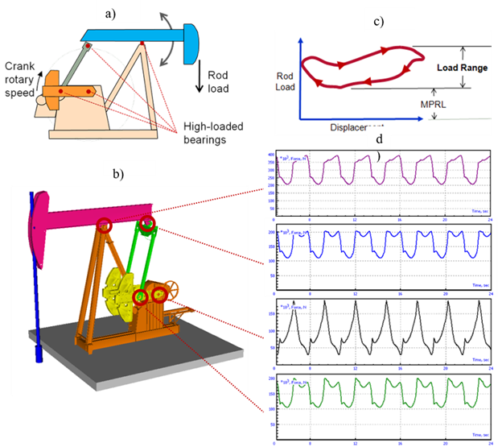
Models Replicate Each System
Integrate pump dynamics to sucker rod dynamics
Predict contact points along the rods for pump load cycle
Predict stresses along the rods
Evaluate wear/life of rods

Slide 6
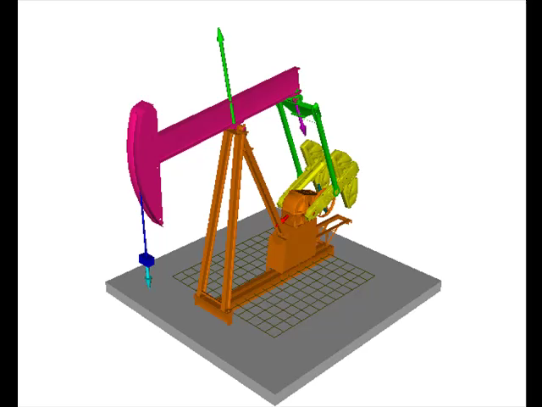
Bring It To Life
Multibody dynamics + FEA to model rod lift pump + system
Loading on top is integrated with sucker rod string
Stiff string approach to predict behavior of sucker rods
Fluid loads & damping integrated into the model

Slide 7
Digital Twinning AL Systems
Evaluate operating loads
The bearing loads are modeled as F(t)
Multi-scale approach, coupling rods and pump(s)
Transient forces include friction, wear & tension/compression
Predictive models optimize maintenance

Slide 8
What Modeling Uncovers
Hybrid Model = FEA + MBD
(finite element analysis + multi-body dynamics)
Stiff string model includes continuous contact points of rods
Tension/Compression distribution along entire rod string
Predict buckling, wear and limit stresses

Slide 9
Features of Time Domain Models
Calibrated models “run” realistically
Scalable from valve to surface
Multi-thread/parallel computing for multiple well analyses
Open physics models handle most strings, valves, centralizers, coatings, etc.
Include pump-off with gas inclusions
Predict wear, fatigue and rod failures

Slide 10
Friction Forces
Mechanical friction can be quantified
Coatings quantitatively evaluated over time
Combine FR efforts for best performance?
Rod breaks, over-load and buckling
Rod/tubing wear - failure

Slide 11
Horizontal Wellbores
Wells have tortuosity and many touch points
Design AL with movement in mind…
Predict rod behavior

Slide 12
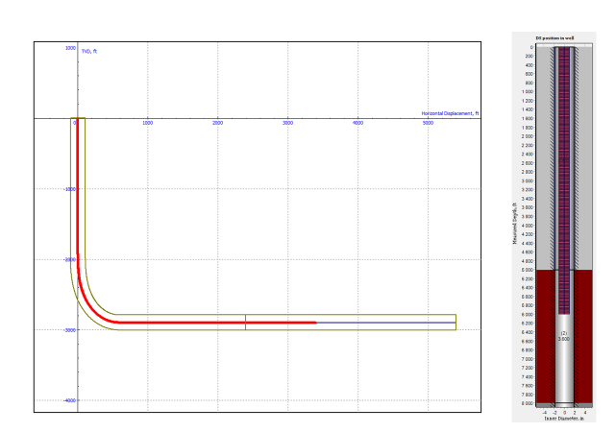
Well Profile
Pump located in lateral at 90° INC

Slide 13
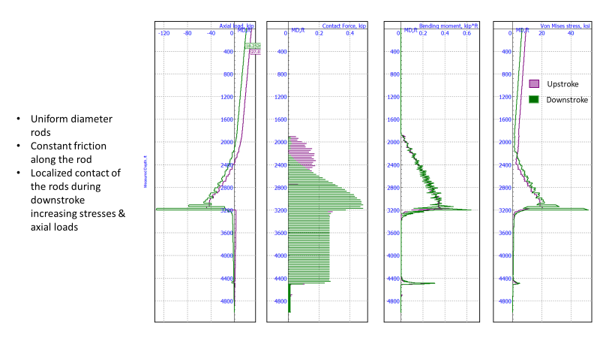
Dashboard View 1
axial load
contact forces
bending moment
Von Mises stress
Notes:
Axial loads increase as we move downward (increasing depth) through the vertical section and curve to 90°. Axial loads go to near zero in the lateral. It is possible to have an axial load > rod weight since we have to overcome frictional forces holding the rods down on t he low side of the hole – many touch points. The contact forces themselves “pushes” rods down (compression) along the curve and into the lateral. They drop off and remain constant until they reach the valve. Bending moments increase with depth along the curve and peak at the heel of the well. There, they drop off sharply in the lateral. There is another small peak at the valve where the tubing comes off the low side of the hole. Von Mises stresses closely mimic bending moments although there are stresses prevailing in the vertical section (tension) that do not show up in bending moments.

Slide 14
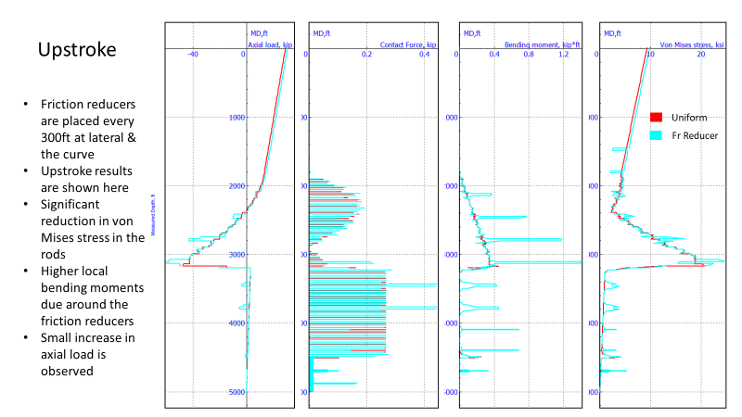
Dashboard - Upstroke
axial load
contact forces
bending moment
Von Mises stress

Slide 15
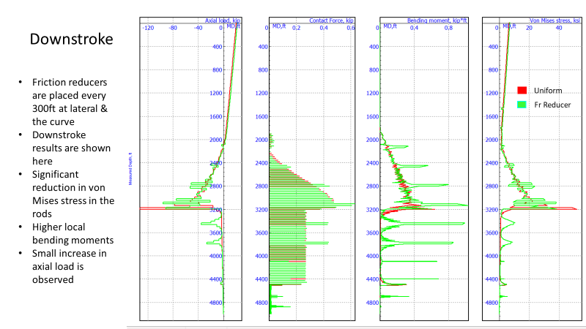
Dashboard - Downstroke
axial load
contact forces
bending moment
Von Mises stress

Slide 16
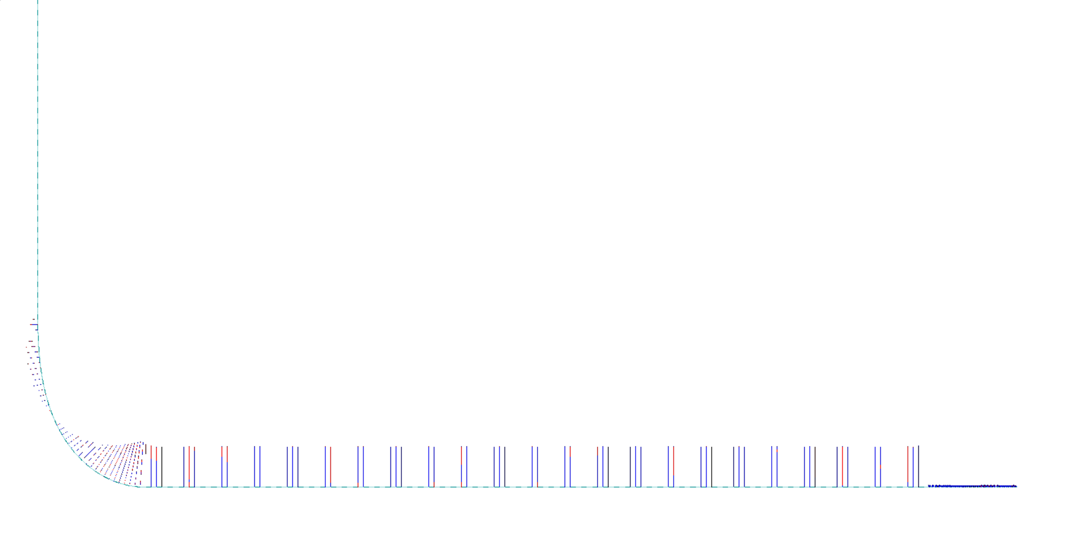
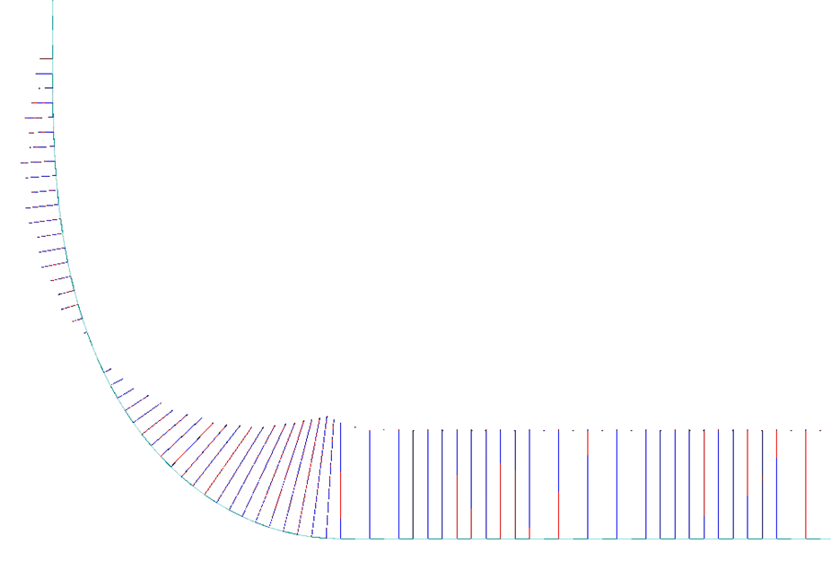
Contact force distribution
force distribution along rod string in lateral into curve

Slide 17
Model and LEARN
Rod Guides
Test tubing anchors
Try Metal coatings
Rollers
Others?
Learning include improved reliability, increased MTBF and lower lift costs

Slide 18
Thank you
Questions?
www.mindmeshterch.com

